Slide 1




WEB PAGES DESIGN
Loops and Additional Controls
Lecturer: Dr. Atheer Akram AbdulRazzaq
Lecture 13.
Class 2.
Time: 10:30 - 12:30
Department: Businesses Information Technology (BIT)

Slide 2
Outline
Outline
while Loop
External JavaScript Files
do Loop
Radio Buttons
Checkboxes
Job Skills Web Page
for Loop
fieldset and legend Elements
Pull-Down Menus
List Boxes
Summary

Slide 3
Outline
while Loop
To perform operations repeatedly, we’ll need to use a loop statement. JavaScript provides three types of loop statements—while loop, do loop, and for loop. We’ll cover the while loop in this section.
Syntax and Semantics
The while loop is the most flexible of the three types of loops. We can use it for any task that needs repetitive operations. Figure1., shows the syntax and semantics for the while loop. The syntax at the left of the figure should look familiar because it’s similar to the if statement syntax.
In the while loop’s heading, after the reserved word while, we need parentheses, a condition, and an opening brace. As you know, a condition is a question that evaluates to true or false. In the while loop’s body, we can have as many statements as we like. Below the body’s statements, we indicate the end of the while loop with a closing brace.
We should put a space between the condition and the opening brace. Also, don’t forget to indent the statements within the braces and align the closing brace with the first character in the loop’s heading.
We’ll need to get comfortable with the jargon. The number of times that a loop repeats is referred to as the number of iterations. It’s possible for a loop to repeat forever. That’s known as an infinite loop, and it’s usually indicative of a bug. It’s also possible for a loop to repeat zero times. There’s no special term for the zero iteration occurrence, but it’s important to be aware that this sometimes happens.

Slide 4
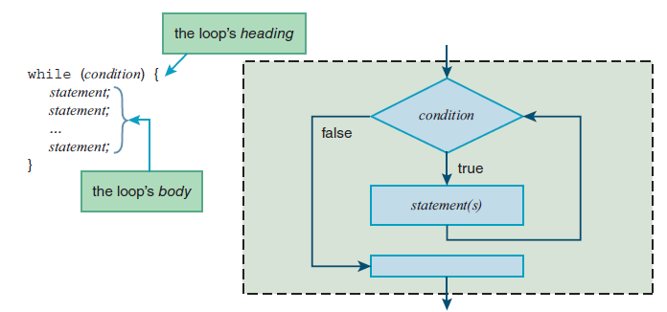
Outline
while Loop (continue…)
Syntax and Semantics
Tracing an Example
The code fragment in example 1., uses a while loop to calculate the factorial of a user-entered number. The main point of the code fragment is to show how a while loop can be used to implement a solution that requires repetitive operations.
Figure1. Syntax and semantics for the while loop

Slide 5
Outline
while Loop (continue…)
Tracing an Example (continue…)
The factorial of a nonnegative integer x is denoted by x! To calculate the factorial of x, you multiply all the integers from 1 up to x. So 4! equals 1 • 2 • 3 • 4, which equals 24. In the code fragment, the while loop uses a count variable as the multiplicand for each loop iteration multiplication operation.
Code fragment in example 1. :-
num = form.elements["number"].valueAsNumber;
factorial = 1;
count = 2;
while (count <= num) {
factorial *= count;
count++;
}
form.elements["result"].value = num + "! = " + factorial;
For the factorial web page, the user enters a value into a number box, and when user clicks form’s button, the JavaScript retrieves user’s entered value. Let’s assume the user enters 3 into the number box. The code fragment’s first statement uses form.elements["number"] to retrieve a control that has an id value of number.
The while loop performs multiple
multiplication operations:
1 * 2 * 3 * … * num

Slide 6

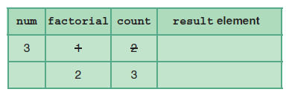
Outline
while Loop (continue…)
Tracing an Example (continue…)
The complete web page code in the example 1., we can see that the number box has an id value of number. The number box’s input value, which we assume to be 3, gets assigned into the num variable.
The second and third statements assign 1 and 2 to the factorial and count variables, respectively.
Remember, the point of a trace is to carefully record what happens. Here’s how you should record the trace after executing the first three lines:
The while loop’s heading checks the condition count <= num. Because 2 is less than 3, the condition is true, and the loop’s body gets executed. The loop body’s first statement multiplies factorial times count and puts the result back into the factorial variable. The loop body’s second statement increments count.
Continuing with the trace, the next step is to jump back to the while loop’s heading and check the condition again. Is the condition count <= num still true? Yes, count, 3, is equal to num, 3.

Slide 7
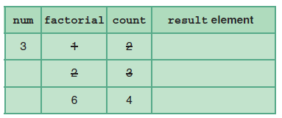
Outline
while Loop (continue…)
Tracing an Example (continue…)
So the loop’s body gets executed again, and here’s what your trace should look like after that execution:
Going back to the top of the loop, and checking the condition, count is 4 and num is 3, so the condition is false. The next step is to jump below the loop and execute the bottom statement. The bottom statement concatenates three entities: num’s value, “! = ”, and factorial’s value.
The concatenated result is “3! = 6”. That string is then assigned into the control specified by form.elements["result"].
Example 1.
<!DOCTYPE html>
<html lang="en">
<head>
<meta charset="utf-8">
<meta name="author" content="AAA">
<title>Factorial Generator</title>

Slide 8
Outline
while Loop (continue…)
Tracing an Example (continue…)
Example 1. (continue…)
<style>
body {background-color: skyblue;}
</style>
<script>
// This function generates a factorial.
function generateFactorial(form) {
var num; // a user-entered number
var factorial; // factorial of num
var count; // multiplicand for factorial calculation
num = form.elements["number"].valueAsNumber;
factorial = 1;
count = 2;
while (count <= num) {
factorial *= count;
count++;
}
form.elements["result"].value = num + "! = " + factorial;
} // end generateFactorial
</script>
</head>

Slide 9
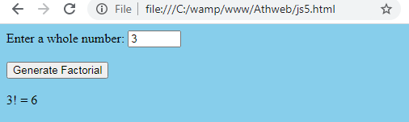
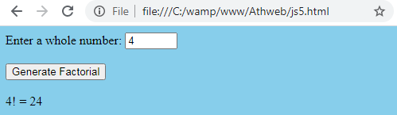
Outline
while Loop (continue…)
Tracing an Example (continue…)
Example 1. (continue…)
<body>
<form>
<label for="number">Enter a whole number:</label>
<input type="number" id="number"
min="0" max="15" step="1" required>
<br><br>
<input type="button" value="Generate Factorial"
onclick="generateFactorial(this.form);">
<br><br>
<output id="result"></output>
</form>
</body>
</html>
Output:

Slide 10
Outline
External JavaScript Files
Web programmers will often use external files to hold their JavaScript function definitions and then have their web pages link to those external JavaScript file(s).
There are several advantages of positioning a web page’s JavaScript function definitions in an external file:
If another web page needs the functionality provided by one of the functions, the second web page can link to the external file and share the function.
If an external JavaScript file and its functions are shared by multiple web pages, maintenance (i.e., fixing bugs and making improvements) becomes easier and storage requirements are reduced. On the other hand, if there were no external JavaScript file, then the web pages would need to have their own copies of the functions.
We must name your JavaScript file with a .js (for JavaScript) file extension. For the file’s content, include documentation comments at the top, followed by the code for your function definitions.
To link a web page to an external JavaScript file, include an empty script container with a src attribute that specifies location of the file. For example:
<script src="compoundInterest.js"></script>
The src attribute’s value specifies that the JavaScript file is stored in the same directory as the HTML file. If you store the JavaScript file elsewhere, then use a path in front of the filename as part of the src’s value.

Slide 11
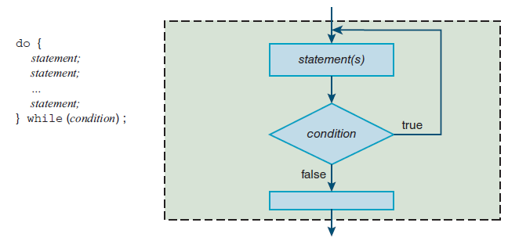
Outline
do Loop
Syntax and Semantics
Note the do loop’s syntax template at the left of Figure 2., It shows the do loop’s condition at the bottom. That contrasts with the while loop, where the condition is at the top. Having the condition tested at the bottom guarantees that the do loop executes at least one time.
In the syntax template, note the semicolon at the right of the condition. That’s also different from the while loop. Finally, note that the while part is on the same line as the closing brace.
Powers of 2 Web Page
Example 2., In this example the web page asks the user to enter the largest power of 2 he or she can think of. If the user enters a number less than 10, the web page tells the user to enter a larger number. After the user submits an answer, the button’s event handler determines whether the entered number is indeed a power of 2.
Figure 2. Syntax and semantics for the do loop

Slide 12
Outline
do Loop (continue…)
Powers of 2 Web Page (continue…)
Example 2., (continue…)
It does so by repeatedly dividing by 2 until the result is less than or equal to 1. If the result is exactly 1, that means the entered number is a power of 2. For example, the following division operations show that 64 is a power of 2, and 80 is not a power of 2:
64 / 2 ⇒ 32, 32 / 2 ⇒ 16, 16 / 2 ⇒ 8, 8 / 2 ⇒ 4, 4 / 2 ⇒ 2, 2 / 2 ⇒ 1
80 / 2 ⇒ 40, 40 / 2 ⇒ 20, 20 / 2 ⇒ 10, 10 / 2 ⇒ 5, 5 / 2 ⇒ 2.5, 2.5 / 2 ⇒ 1.25, 1.25 / 2 ⇒ .625
Example 2A., shows the web page’s body container. As you skim through it, note the body container’s two child elements—a form and an image. By default, a form is a block element, so it would normally span the width of the web page’s viewport, causing the image to display below the form. To get the image to display at the right of the form, we use a little CSS magic.
Take a look at Example 2B., style container, and note this flexbox CSS rule:
body {display: flex; align-items: flex-start;}
The display: flex property-value pair converts the body container into a flexbox and causes the form’s width to conform to the size of its content.
The align-items: flex-start property value causes the flex container’s child elements to be aligned at the top.
exactly 1
Less than 1

Slide 13
Outline
do Loop (continue…)
Powers of 2 Web Page (continue…)
The style container’s next two rules tweak the layout’s margins to further improve the layout:
form, img {margin: 20px 20px 0;}
h1 {margin-top: 0;}
The style container’s last CSS rule applies a very light shade of pink to the web page’s background: body {background-color: rgb(255, 246, 250);}
Example 2A.
<body>
<form>
<h1>MATH IS FUN!</h1>
<label for="number">What is the largest power of 2
you can think of?</label>
<br><br>
<input type="number" id="number" min="10" step="1" required>
<br><br>
<input type="button" value="Submit“
onclick="checkForPowerOf2 (this.form);">
<br><br>
<output id="result"></output>
</form>
<img src="../images/girlJuggling.png" width="128" height="212" alt="">
</body>
</html>

Slide 14
Outline
do Loop (continue…)
Powers of 2 Web Page (continue…)
Example 2B.
<!DOCTYPE html>
<html lang="en">
<head>
<meta charset="utf-8">
<meta name="author" content="AAA">
<title>Powers of 2</title>
<style>
body {display: flex; align-items: flex-start;}
form, img {margin: 20px 20px 0;}
h1 {margin-top: 0;}
body {background-color: rgb(255, 246, 250);}
</style>
<script>
// This function checks whether the user entered a power of 2.
function checkForPowerOf2(form) {
var numBox; // number control
var output; // output element that displays the response
var num; // user-entered number
var quotient; // number that is repeatedly divided by 2
var wholeNumber; // is the quotient a whole number?
We examine the web page’s script container with its checkForPowerOf2 function definition. Example 2B.,shows trivial stuff—the function heading and the variable declarations.

Slide 15
Outline
do Loop (continue…)
Powers of 2 Web Page (continue…)
Example 2C., shows the good stuff. The function checks the number box and displays an error message for invalid input.
If the user enters valid input, the function uses a do loop to repeatedly divide by 2 while the resulting quotient is greater than 1. After the loop, if the final quotient is exactly 1, that means the user entered a power of 2, and the web page displays a congratulatory message.
Note the condition at the bottom of the do loop:
} while (wholeNumber && quotient > 1);
Example 2C.
numBox = form.elements["number"];
output = form.elements["result"];
if (!numBox.checkValidity()) {
output.value =
"Invalid input. You must enter an integer 10 or greater.";
}
else {
num = quotient = numBox.valueAsNumber;
wholeNumber = true;
do {
quotient /= 2;
if (quotient != Math.floor(quotient)) {
wholeNumber = false;
}
compound assignment operator for division
check for quotient not
being a whole number

Slide 16
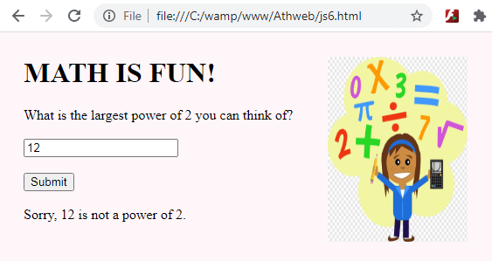
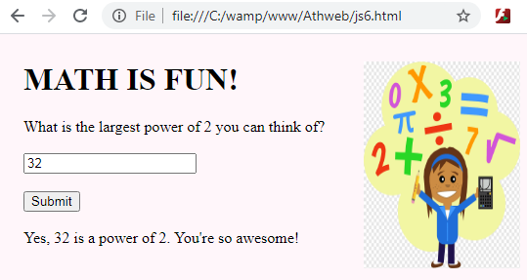
Outline
do Loop (continue…)
Powers of 2 Web Page (continue…)
Example 2C. (continue…)
} while (wholeNumber && quotient > 1);
if (quotient == 1) {
output.value = "Yes, " + num + " is a power of 2." +
" You're so awesome!";
}
else {
output.value = "Sorry, " + num + " is not a power of 2.";
}
} // end else
} // end checkForPowerOf2
</script>
</head>
Output:

Slide 17
Outline
do Loop (continue…)
Using a Boolean Variable to Terminate the Loop
The Boolean data type is for variables that hold the value true or the value false, and those variables are referred to as Boolean variables.
In example 2., (2C) the wholeNumber variable is a Boolean variable. It holds value true if most recently generated quotient is a whole number and false otherwise.
In the checkForPowerOf2 function, note how we assign true to wholeNumber above the loop and then inside the loop, we assign false to wholeNumber if the new quotient is not a whole number. Note how we use Math.floor to see if the new quotient is not a whole number:
if (quotient != Math.floor(quotient)) {
Remember that the floor method rounds down, so if the quotient is not a whole number, rounding down returns a value different from the original value. And the != operator evaluates to true if the values are different. At the bottom of the loop, we use wholeNumber in the do loop’s condition:
} while (wholeNumber && quotient > 1);
If wholeNumber has the value false, then the condition pares down to false && quotient > 1. Remember that if you use false with the && operator, the result is false, regardless of other operand’s value. This do loop provides same functionality without using a Boolean variable:
do {
quotient /= 2;
} while (quotient != Math.floor(quotient) && quotient > 1);
The benefit of using a Boolean variable, It can lead to more readable code, as is case in do loop condition in Powers of 2 web page. A Boolean variable can be used to keep track of a situation in which there’s a state with one of two possible values.

Slide 18


Outline
Radio Buttons
Radio buttons come in a group, where only one radio button in a group can be selected at a time. When one of the buttons in the group is clicked, it gets selected and the other buttons get unselected. That’s different from regular buttons, which are standalone entities.
HTML Attributes
Here are the radio button control’s more important attributes:
To create a radio button control, you’ll need an input element with type="radio".
To group radio buttons together, you’ll need the radio buttons to have a name attribute with the same value.
For example, the following radio buttons form a radio button group because they have the same “color” value for their name attribute:
<input type="radio" name="color" value="black" checked>Black&nbsp;
&nbsp;
<input type="radio" name="color" value="pistachio">Pistachio&nbsp;
&nbsp;
<input type="radio" name="color" value="indigoBlue">Indigo Blue
Here’s how the preceding code looks when rendered on a browser window:
same name
causes the radio button to be preselected

Slide 19
Outline
Radio Buttons (continue…)
The default is for radio buttons to be unselected, and that’s why the second and third radio buttons are unselected. If a radio button has a checked attribute, then the browser preselects the radio button.
In the preceding code fragment, note the checked attribute for the first radio button. That’s why there’s a selected dot in the black radio button.
If the user clicks on a different radio button, then that other radio button gets selected, and the selected dot disappears from the black radio button. If the user clicks on an already selected radio button, nothing happens.
In the prior code fragment, you can see “Black,” “Pistachio,” and “Indigo Blue” after the three input tags. Those plain-text strings serve as labels for the three radio buttons. If you want your web page to be accessible to the visually impaired, you should use label elements instead of plain text for your labels.
By using the following label element, a visually impaired user’s screen reader will say “black” (because “Black” appears within the label element, after the input element) to indicate what the radio button is for.
<label><input type="radio" name="color" value="black" checked>
Black</label>
Using JavaScript to Retrieve Radio Button Objects
To retrieve a collection of radio buttons, we once again use form.elements, but this time the []’s go around the name value for the radio buttons that are grouped together. For example, here’s how you can retrieve the radio button collection for a group of radio buttons where “color” is the name of the radio button group:
tshirtRBs = form.elements["color"];

Slide 20
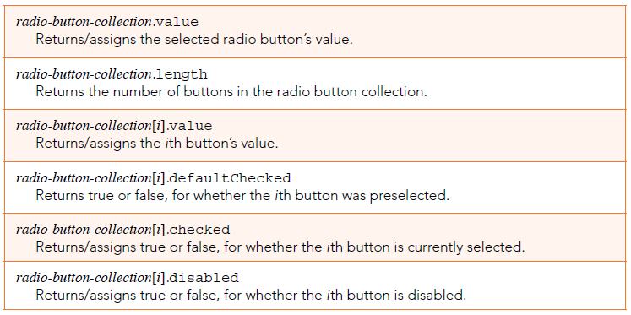
Outline
Radio Buttons (continue…)
Using JavaScript to Retrieve Radio Button Objects (continue…)
To retrieve an individual radio button within the collection, you use the notation collection[index], where an index value of 0 refers to the collection’s first object, an index value of 1 refers to the collection’s second object, and so on. For example, you could use the following code to retrieve the second radio button in the tshirtRBs collection: pistachioRB = tshirtRBs[1];
We can get the value of the selected radio button with the help of the collection’s value property. For example:
alert("You ordered a " + tshirtRBs.value + " t-shirt.");
If no radio button is selected, then the value property returns the empty string. In Figure 3., note how several of properties’ descriptions start with “Returns” and others start with “Returns/assigns.” The properties that start with “Returns” are read-only properties, meaning that you can read the property’s value, but you cannot update its value. The properties that start with “Returns/assigns” allow you to read the property’s value and update its value.
Figure 3. Properties for radio button collections and for individual radio buttons

Slide 21
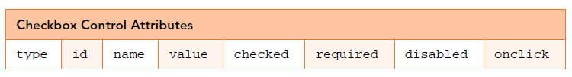
Outline
Checkboxes
When a checkbox is clicked, a check appears in the checkbox. When the checkbox is clicked again, the check disappears. Checkboxes are sometimes standalone entities, and sometimes they come in groups. If they’re in a group, they’re not limited to just one selection (as radio buttons are). None, some, or all of them can be selected.
HTML Attributes
Here are the checkbox control’s more important attributes:
We’ll need an input element with type="checkbox". For a standalone checkbox, we’ll normally want to include an id attribute, so your event handler JavaScript can use form.elements[checkbox-id] to access the checkbox. Here’s an example that implements a standalone checkbox:
I accept the terms and conditions of this agreement
<span class="barely-visible">(subject to corporate interpretation and revision) </span>:
<input type="checkbox" id="accept-terms" required onclick="acceptTerms (this.form); " >
Note the id attribute’s value, accept-terms. The HTML5 standard does not allow spaces within id values. If you want to use multiple words for an id value, use hyphens to separate the words, as exemplified by accept-terms.

Slide 22
Outline
Checkboxes (continue…)
Spaces aren’t allowed within id attribute values and class attribute values because those values need to be available for class selectors. If spaces were allowed, then the browser engine would have to be able to process the following selector rules. With the spaces, that would be difficult, if not impossible.
#accept terms {color: red;}
.clean modern font {font-family: "Century Gothic", Geneva, sans-serif;}
Note the required attribute. It indicates that the checkbox must be selected; otherwise, the checkbox is considered to have invalid input.
To group checkboxes together, you’ll need the checkboxes to have the same name attribute value. For example, the following checkboxes form a checkbox group because they have the same “jobSkills” value for their name attribute:
<input type="checkbox" name="jobSkills" value="HTML5" checked>
know HTML5<br>
<input type="checkbox" name="jobSkills" value="CSS"> know CSS<br>
<input type="checkbox" name="jobSkills" value="coffee making">
make good coffee<br><br>
Here’s what this code fragment looks like when rendered on a browser window:
illegal spaces
causes the checkbox to be preselected
same name

Slide 23

Outline
Checkboxes (continue…)
Here’s what this code fragment looks like when rendered on a browser window:
To retrieve the checkbox presented earlier where the user accepted a form’s terms and conditions, you could use the following code, where “accept-terms” is the checkbox’s id value:
acceptTermsCB = form.elements["accept-terms"];
To retrieve a checkbox that’s part of a group of checkboxes, you first retrieve the checkbox’s collection by using form.elements with []’s around the checkbox group’s name value. We could use the following code, where “jobSkills” is the name of the checkbox group:
jobSkillsCBs = form.elements["jobSkills"];
JavaScript Properties
In figure 4., A checkbox collection very often has more than one checkbox that’s selected, so returning a single selected value for a checkbox collection doesn’t make sense. On the other hand, returning multiple values for a checkbox collection, one for each selected checkbox, does make sense, and web page event handlers do that fairly often.

Slide 24
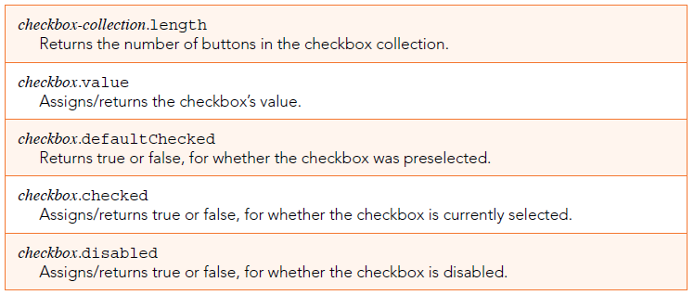
Outline
Checkboxes (continue…)
JavaScript Properties (continue…)
In Figure 4., the properties below the length property apply to individual checkboxes, and they work the same as for individual radio buttons. For example, a checkbox’s checked property indicates whether the checkbox is selected or not.
For a standalone checkbox, like accept-TermsCB, you could use this code to know whether the checkbox is selected:
if (acceptTermsCB.checked) {
For a checkbox in a jobSkillsCBs checkbox collection, we could use this code to know whether the third checkbox is selected:
if (jobSkillsCBs[2].checked) {
Figure 4. Properties for checkbox collections and for individual collections

Slide 25
Outline
Job Skills Web Page
Peruse the Job Skills web page body container in example 3A. Note that each checkbox element includes a required attribute. That means the user is supposed to select all three checkboxes. Note the Submit button at the bottom, which, when clicked, calls the checkInput function.
Example 3B. shows the web page’s checkInput function. The function examines the checkboxes and displays a message at the bottom that describes whether the applicant is fit for hire. Specifically, if all three job skills checkboxes are selected, the message indicates that the user is hired. Otherwise, the message indicates the user is not hired and displays values of the skills checkboxes that are not selected.
Example 3A, and 3B.,
<!DOCTYPE html>
<html lang="en">
<head>
<meta charset="utf-8">
<meta name="author" content="AAA">
<title>Job Application</title>
<script>
// Evaluate user's job skills and generate hiring plan.
function checkInput(form) {
var message; // hiring plan after examining job skills
var i = 0;
if (form.checkValidity()) {
message = "You're hired! We need a website overhaul." +
" Have it done by Saturday midnight. We go live on Sunday.";
}

Slide 26
Outline
Job Skills Web Page (continue…)
Example 3A, and 3B., (continue…)
else {
message = "Sorry we can't hire you." + " You are deficient in these areas:";
jobSkillsCBs = form.elements["jobSkills"];
while (i < jobSkillsCBs.length) {
if (!jobSkillsCBs[i].checkValidity()) {
message += "<br>" + jobSkillsCBs[i].value;
}
i++;
} // end while
} // end if
document.getElementById("message").innerHTML = message;
} // end checkInput
</script>
</head>
<body>
<h2>Web Programmer Job Application</h2>
<p>We need the following skillset. Which skills do you possess?</p>
<form>
<input type="checkbox" name="jobSkills" value="HTML5" required>
know HTML5<br>
<input type="checkbox" name="jobSkills" value="CSS" required>
know CSS<br>
<input type="checkbox" name="jobSkills" value="coffee making" required>
make good coffee<br><br>

Slide 27
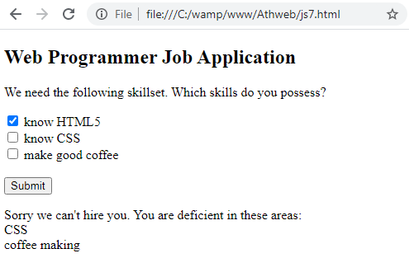
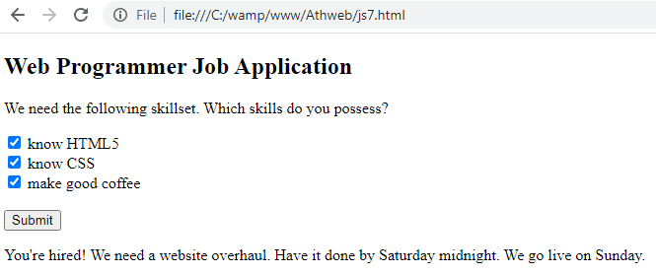
Outline
Job Skills Web Page (continue…)
Example 3A, and 3B., (continue…)
<input type="button" value="Submit" onclick="checkInput(this.form);">
</form>
<p id="message"></p>
</body>
</html>
Output:
for Loop
Figure 5., shows the while loop used in the Job Skills web page and a functionally equivalent for loop. Both versions use a counter variable, i, that gets initialized to 0 and gets incremented each time through the loop. With a for loop, the counter mechanism is implemented within the loop’s heading. It’s such a foundational part of a for loop that the counter variable is given a special name—an index variable.

Slide 28
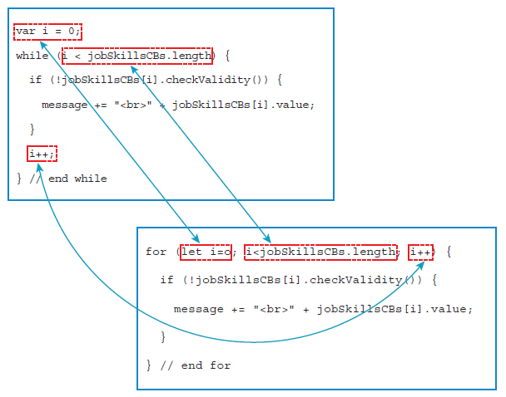
Outline
for Loop (continue…)
The for loop heading is formed with three components—the initialization, condition, and update components—with the components separated by semicolons:
for (initialization; condition; update) {
We might think that using var instead of let for declaring your index variable would accomplish the same thing. Nope. If you declare a variable with var, the variable’s scope is the entire function. Normally, that won’t create problems, but you should do more than strive for acceptable normalcy.
In the following for loop heading, note that there are no spaces surrounding the = operator and the < operator:
for (let i=0; i<jobSkillsCBs.length; i++) {
Figure 5. while loop versus for loop comparison for Job Skills web page

Slide 29

Outline
fieldset and legend Elements
To make the groupings more obvious to someone viewing the web page, you can add a border around each group and embed a caption within the border. Note the following example, which provides a border and caption for a group of three color-selection radio buttons:
To make a border, surround the radio button elements with a fieldset container. To make a caption, include a legend element within the fieldset container. Here’s the relevant code that was used to create preceding radio button group:
<style>
fieldset {display: inline;}
</style>
...
<fieldset>
<legend>Choose your t-shirt's color</legend>
<input type="radio" name="color" value="black">Black
&nbsp;&nbsp;
<input type="radio" name="color" value="pistachio">Pistachio
&nbsp;&nbsp;
<input type="radio" name="color" value="indigoBlue">Indigo Blue
</fieldset>

Slide 30
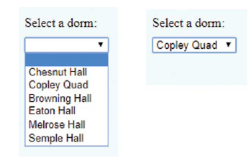
Outline
Pull-Down Menus
When a user clicks a pull-down menu’s down arrow, that causes a list of selections to appear below the down arrow. When the user clicks one of selections, the list collapses and the selected value appears next to down arrow.
What follows is an example from Dormitory Blog web page. It shows what happens when a user clicks pull-down menu’s down arrow and then clicks Copley Quad selection:
To implement a pull-down menu, we need a select element container with option elements inside it. Here’s code that implements the dorm selection pull-down menu:
<select id="dorm" required>
<option label=" "></option>
<option>Chesnut Hall</option>
<option>Copley Quad</option>
<option>Browning Hall</option>
<option>Eaton Hall</option>
<option>Melrose Hall</option>
<option>Semple Hall</option>
</select>

Slide 31


Outline
Pull-Down Menus (continue…)
When a pull-down menu’s option list is collapsed, it displays the value associated with the option that’s currently selected. By clicking an option, the user determines the current selection. But when the pull-down menu first loads, the default current selection is the first option.
HTML Attributes
Typically, select element syntax is sparse. Just a few attributes are commonly used with the select element for pull-down menus, and here they are:
We should be familiar with the id and disabled attributes since they work the same for all elements. The required attribute means that the user has to select an option with a nonempty string value. For the Dormitory Blog web page’s pull-down menu, its select container defines an empty-string value for its first option, so if that option is selected, the form’s checkValidity method flags it as an invalid input.
The select element works in conjunction with the option element. Like the select element, the option element’s syntax is sparse. Here are the more commonly used attributes for the option element when it’s positioned within a select element:

Slide 32
Outline
Pull-Down Menus (continue…)
We’ve already described the label attribute—it provides a label for the option when the option is displayed as part of the pull-down menu. The selected attribute is an empty attribute in that, if it’s included, it appears by itself without a value. If an option element has a selected attribute, the option’s value is preselected within the pull-down menu.
If an option element has a selected attribute, the option’s value is preselected within the pull-down menu. If no option element has a selected attribute, then the first option is preselected by default.
Using JavaScript with Pull-Down Menus
The pull-down menu’s more popular properties are value and selectedIndex, both of which come from the select element’s object.
The select element object’s value property holds the value associated with the currently selected option.
We can see how we use the value property to retrieve the selected dorm from the dorm pull-down menu. Here’s the relevant code:
dorm = form.elements["dorm"];
newComment = form.elements["newComment"];
...
addedVerbiage = dorm.value + ":\n" + newComment.value;
The value property goes both ways—you can use it to read the pull-down menu’s selected value, and you can also use it to update the pull-down menu’s selected value. So if you want to update the selection to “Eaton Hall,” you could do this:
dorm.value = "Eaton Hall";

Slide 33
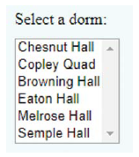
Outline
List Boxes
As We know, pull-down menus collapse after the user selects an option. With a list box, the list of options remains viewable after the user selects an option. For example, here’s what dorms input control looks like implemented as a list box instead of a pull-down menu:
A drawback of a list box is that it takes up more space. So if you have lots of options, you should probably use a pull-down menu rather than a list box. But with relatively few options, a list box can be more user friendly—no need to click a down arrow to figure out what’s going on.
Another list box advantage is that you can configure them to allow users to select more than one option.
The syntax for list boxes is the same as for pull-down menus, but with a few attributes added. Both controls use a select container that surrounds option elements. For example, here’s the code that generates the dorms list box:
<select id="dorm" multiple size="6" required>
<option>Chesnut Hall</option>
<option>Copley Quad</option>
<option> Browning Hall</option>

Slide 34

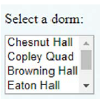
Outline
List Boxes (continue…)
<option> Eaton Hall</option>
<option> Melrose Hall</option>
<option> Semple Hall</option>
</select>
HTML Attributes
Here are the attributes that are commonly used with select element for list boxes:
The multiple and size attributes are what distinguishes a list box from a pull-down menu. The multiple attribute is an empty attribute. If you include it with a select element, the user will be able to select multiple options.
The size attribute specifies the number of options that display simultaneously. In the list box code fragment shown in the previous subsection, you can see size="6" for the select start tag, and that’s why all six options display simultaneously in the list box.
If a select element has a multiple attribute and there’s no size attribute, then the default size is 4. So in the list box code fragment, if there were no size attribute, the list box would look like this:

Slide 35

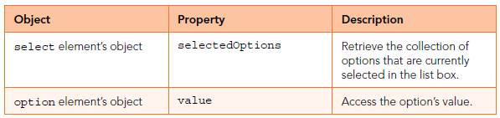
Outline
List Boxes (continue…)
If a list box’s size is less than the list box’s number of options, then the browser engine provides a vertical scroll bar to help with the user’s selection process. After making a selection, if the user wants to make another selection, he/she can ctrl+click on the additional selection.
The common attributes for the option element are the same for list boxes and pull-down menus, here you go:
If your list box allows only one selection (because there’s no multiple attribute), then you’re good to go—the value property works the same as for pull-down menus.
If your list box allows multiple selections, you’ll want to use a different set of properties to process the user’s selections. This table highlights those properties:

Slide 36
Outline
Summary
In this lecture we explained the while loop, that were loops through a block of code as long as a specified condition was true.
Also we clarified the external JavaScript files, which were a great way to increased efficiency and improved maintainability across a website.
Also we explained briefly the do/while statement creates a loop that executes a block of code once, before checking if the condition was true, then it will repeat the loop as long as the condition was true.
This lecture highlighted the radio button that was a control element allows the user to choose only one of a predefined set of mutually exclusive options.
In this lecture we explained the Checkboxes, that were used for instances where a user may wish to select multiple options, such as in the instance of a “check all that apply” question, in forms.
Also this lecture highlighted the for statement, that created a loop that was executed as long as a condition was true. The loop continued to run as long as the condition was true, then stop when the condition becomes false.
In this lecture Described the <fieldset> tag , that was used for grouping related form elements. By used the fieldset tag and the legend tag, we could make the forms much easier to understand for users.
We clarified the drop-down menus, which used to pull all of the pages in a certain category together in one organized element.
This lecture explained briefly the Pull-Down list, which was a menu that allows the user to choose one option from multiple ones.
In the last section in this lecture we explained the ListBox , that was a graphical user interface for displaying a list of items with multi-selection options.

Slide 37


THANK YOU

Slide 38

Good Luck

